Slide 1
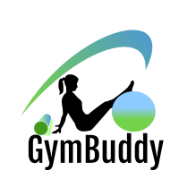
GymBuddy
Presentation
Presented by Group 6:
Bhavan Mehta
Ahnaful Arephin
Vallabhan Kudlu Ramakrishnan
Notes:
Hello everyone and welcome to our presentation for GymBuddy.

Slide 2
Presentation Outline
Current Problems
Statistics
What is GymBuddy?
Business Process Model
User Interface (UI)
Benefits of GymBuddy
Future Scope
Notes:
In this presentation, we will discuss the problems that gym members currently face, some statistics showing the rapid increase of gym membership across the US, our solution to this problem, the business process model and the user interface, benefits of using GymBuddy, and the future scope of the app.

Slide 3
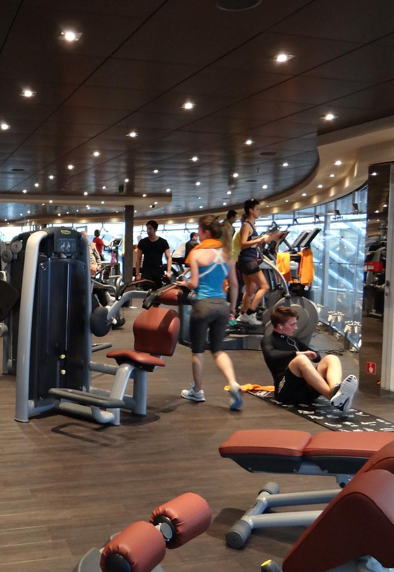
Current Problems
Gyms are super busy
Equipment can be unavailable when you need it
Workout routines are unknown/unfamiliar
Notes:
Before a gym member goes to the gym, they may have no idea how busy the gym is currently and would have to waste a lot of time and effort traveling to the location just to see that the gym is too busy. Currently, there is no system that displays real-time on-demand information that shows how busy a gym is or what equipment is available at that particular gym that is available for use.
There are many different apps that are available on the App Store and Google Play Store that provide the user with very general fitness guides and tips. However, there is nothing currently available that is tailored to what equipment a gym has and what workout routines can be performed based on what equipment is currently available. Implementing a system that can provide the aforementioned services to a gym member would be very useful to both gym members and the gyms itself.

Slide 4
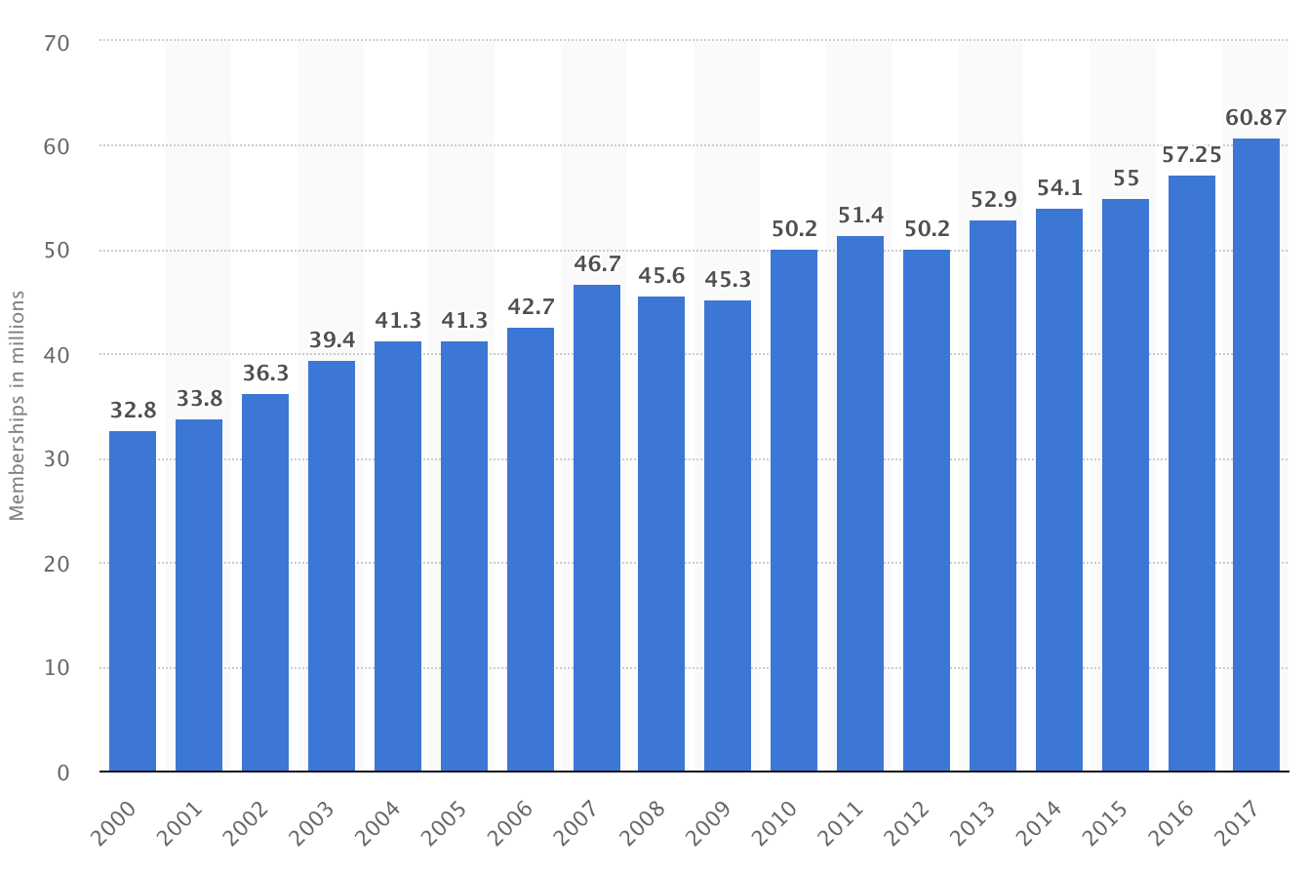
Gym Membership Statistics
Gym membership has nearly doubled from 2000 to 2017
Source: Statista
Notes:
Staying healthy is a vital part of everyday life for many people. Going to the gym is one method people use to stay in shape and stay healthy. According to Statista.com, membership at gyms and fitness centers have nearly doubled since 2000. This rapid influx of new memberships has made these gyms and fitness centers very busy at peak periods and made it harder for members to find a good time to visit the gym and perform their desired workouts. As more and more gyms open up to accommodate and invite more members, it becomes harder to find and determine the best time to visit the gym and perform workouts.

Slide 5
What is GymBuddy?
GymBuddy is an app designed for gym members that are frustrated with going to a gym that is too busy or has equipment that feels like is ALWAYS in use and never available.
It will provide information such as
How busy the gym is currently
Give average wait time and occupancy rate
What equipment is currently available for use
Provide workout recommendations.

Slide 6
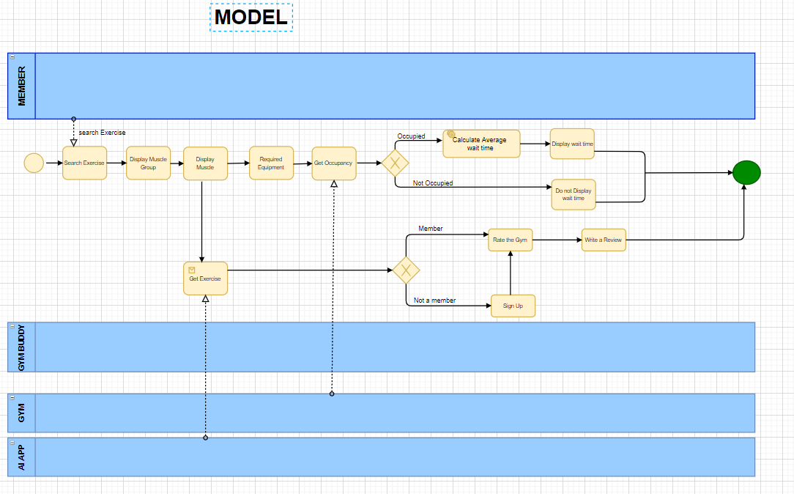
Business Process Model and Notation

Slide 7
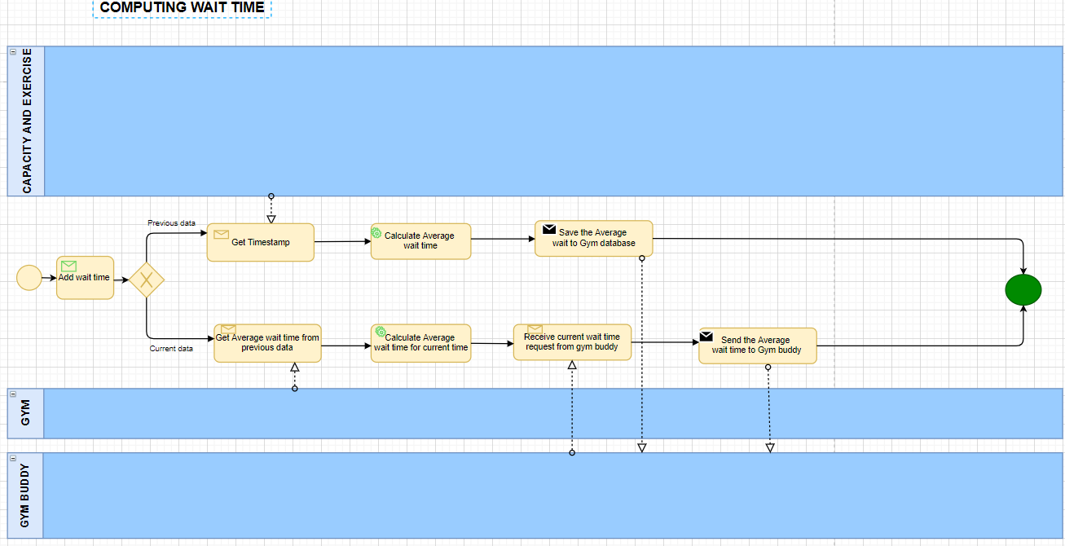

Slide 8
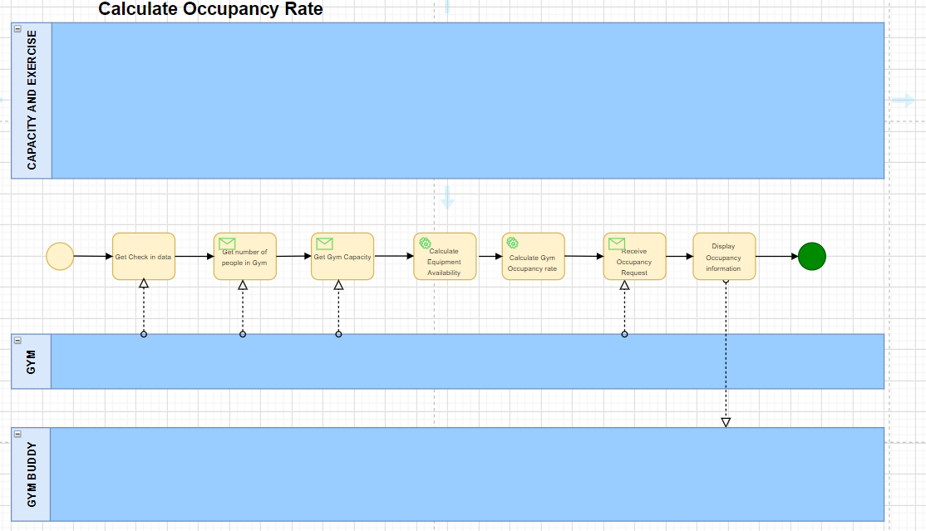

Slide 9
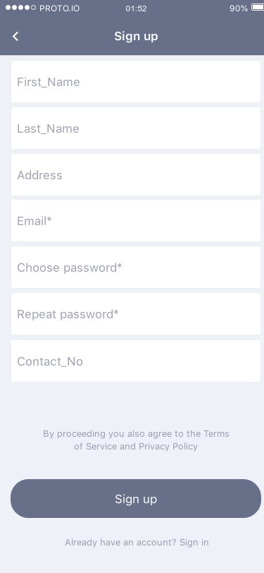
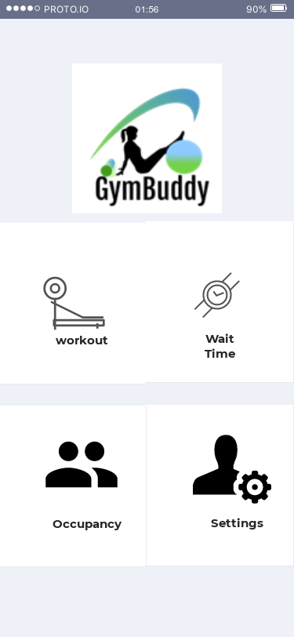
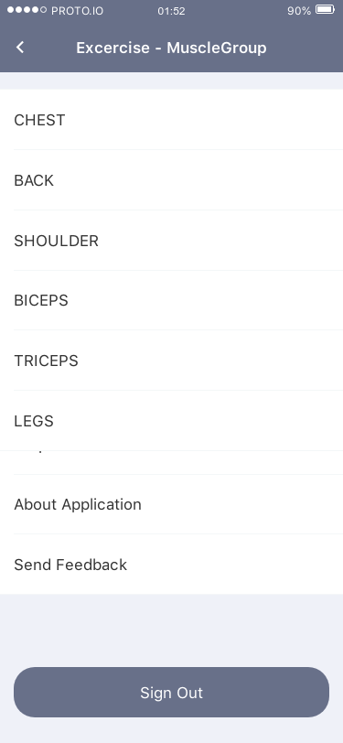
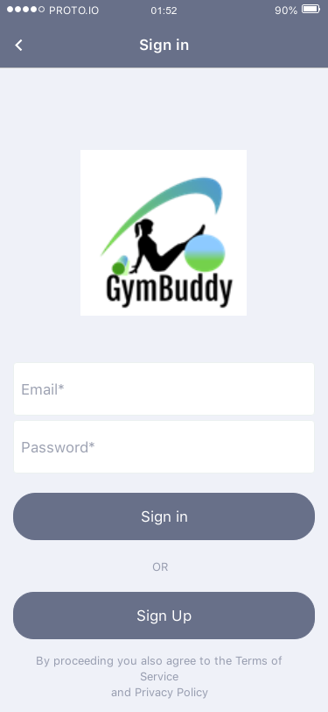
Interface

Slide 10
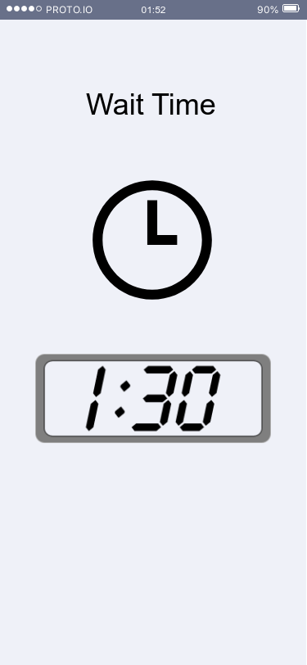
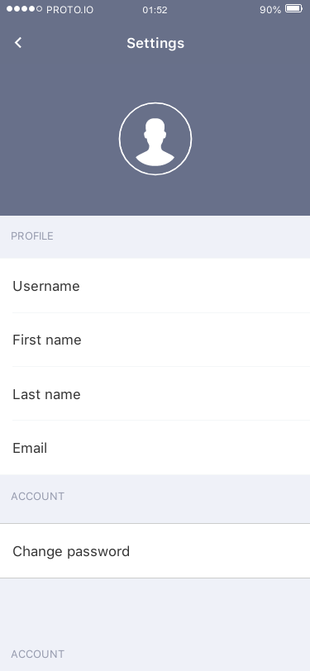
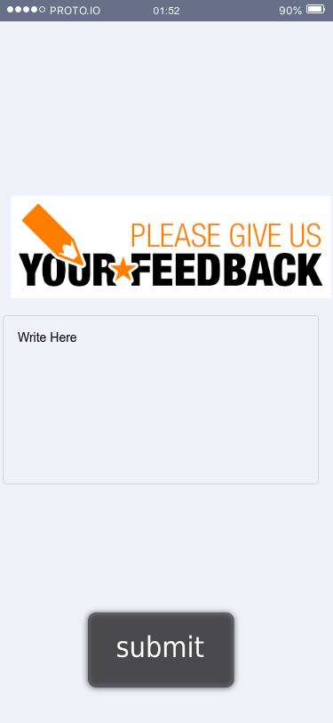

Slide 11
Benefits
The greatest benefit that GymBuddy will provide is a service that does not currently exist in the market
These benefits include:
Providing gym members with the ability to plan their workout around their schedule and how busy a gym may be
Allowing Gyms that are on GymBuddy to manage their members and equipment better
Giving new Gym Members, that are not familiar with workout routines, an easier time with figuring out what workout to do

Slide 12
Future Scope
Real-time data collection will allow gyms to make better business decisions and provide additional services as needed
Providing historical data to the gym member
Expanding this service to other gyms in the local area, and eventually around the country
Expanding the service to include other forms of fitness, such as crossfit, running, etc.

Slide 13
Thank you!

